Slide 1
Central Processing Unit (CPU)
CPU Organizations
Instruction Formats
Addressing Modes
RISC and CISC Characteristics

Slide 2
Central Processing Unit (CPU)
CPU performs the bulk of data-processing operations
It consists of 3 major parts:
Register set: stores intermediate data during execution of an instruction
ALU: performs various micro-operations required
Control unit: supervises register transfers and instructs ALU
On the basis of the general organization of CPU register, CPU architecture can be:
RISC, and
CISC
On the basis of memory usage for program and data, CPU architecture can be:
Stored program concept (Von Neumann architecture) architecture
Harvard Computer architectures

Slide 3
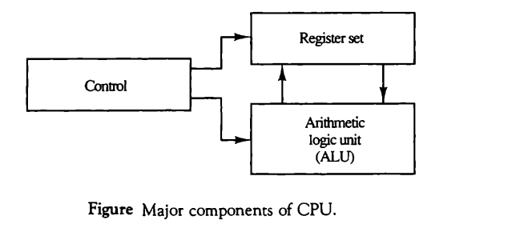
Contd..
Major components of CPU is as shown in below fig:

Slide 4
Questions
What is the function of CPU? Explain the parts of CPU in detail.
Differentiate between Harvard architecture and Von Neumann architecture.

Slide 5
General register organization
The block diagram of register organization inside the CPU is shown in the next slide.
It describe how each register communicates with the ALU through buses.

Slide 6
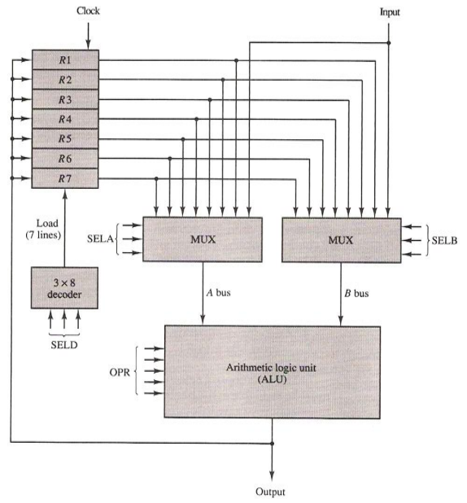

Slide 7

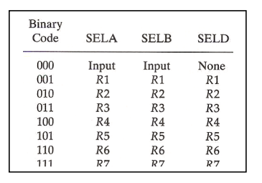
General Register Organization (contd..)
Control Word for above CPU is as below:
Encoding of the register selection fields and ALU operations is given below:

Slide 8
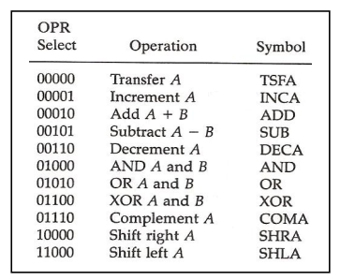
Contd..

Slide 9

Contd..
Example:
Binary control word for this micro-operation statement is:

Slide 10
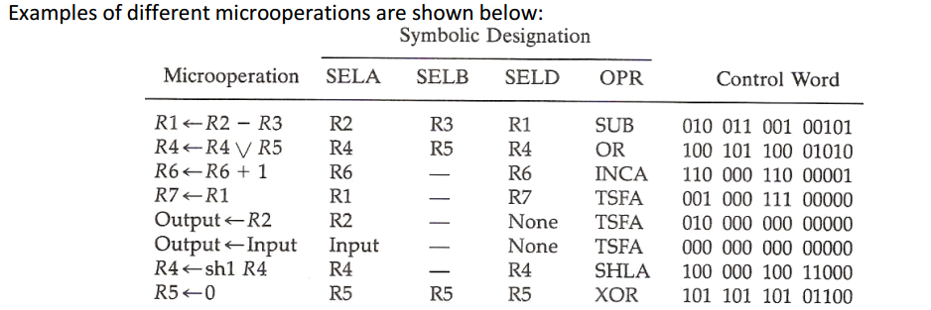

Slide 11
Stack Organization
This is useful last-in, first-out (LIFO) list (actually storage device) included in most CPU’s.
Stack in digital computers is essentially a memory unit with a stack pointer (SP).
SP is simply an address register that points stack top.
Two operations of a stack are the insertion (push) and deletion (pop) of items.
In a computer stack, nothing is pushed or popped; these operations are simulated by incrementing or decrementing the SP register.

Slide 12
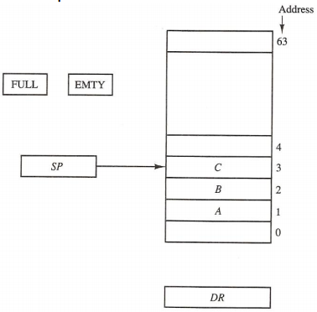
Register stack
It is the collection of finite number of registers.
Stack pointer (SP) points to the register that is currently at the top of stack.

Slide 13
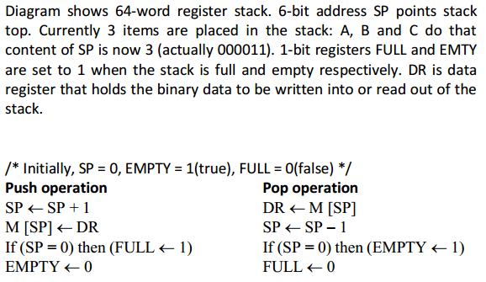

Slide 14
Memory stack
A portion of memory can be used as a stack with a processor register as a SP.
Figure below shows a portion of memory partitioned into 3 parts: program, data and stack.

Slide 15
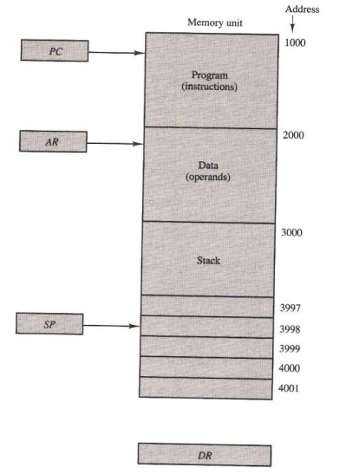

Slide 16
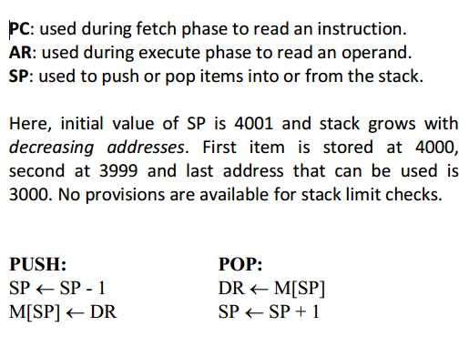

Slide 17
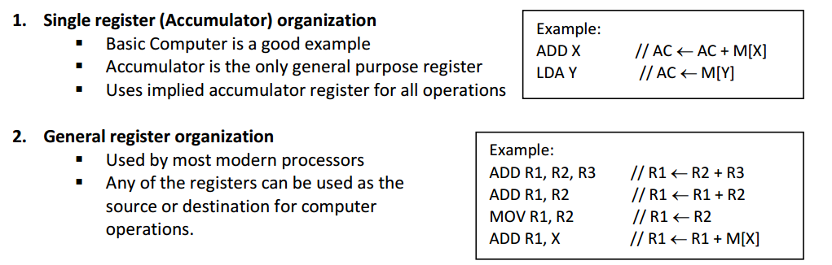
Processor Organization
In general, most processors are organized in one of 3 ways:

Slide 18
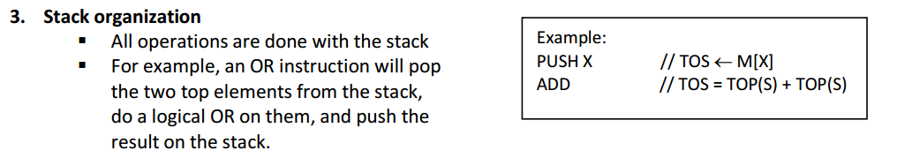

Slide 19
Types of instruction
Instruction format of a computer instruction usually contains 3 fields: operation code field (opcode), address field and mode field.
The number of address fields in the instruction format depends on the internal organization of CPU.
On the basis of no. of address field we can categorize the instruction as below:
Three-Address Instructions
Computers with three-address instruction formats can use each address field to specify either a processor register or a memory operand.

Slide 20
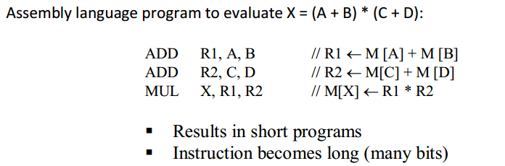
Two-Address Instructions
These instructions are most common in commercial computers.
Program to evaluate X = (A + B) * (C + D):

Slide 21
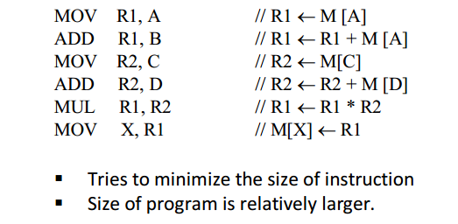
One-Address Instructions
One-address instruction uses an implied accumulator (AC) register for all data manipulation.
All operations are done between AC and memory operand.
Program to evaluate X = (A + B) * (C + D):

Slide 22
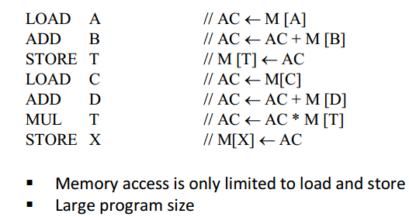
Zero-Address Instructions
A stack-organized computer uses this type of instructions.
Program to evaluate X = (A + B) * (C + D):

Slide 23
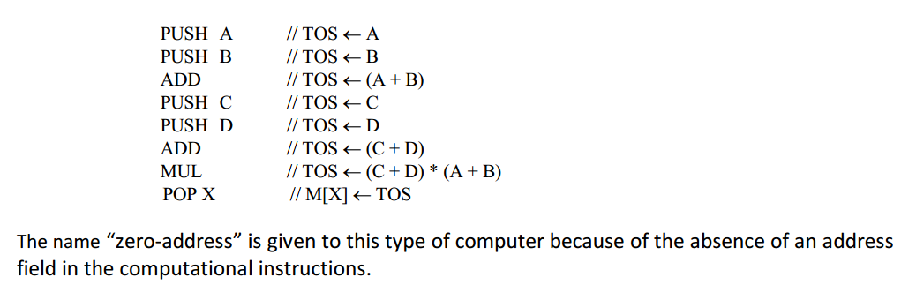

Slide 24
Addressing Modes
Operation field of an instruction specifies the operation that must be executed on some data stored in computer register or memory words.
The way operands (data) are chosen during program execution depends on the addressing mode of the instruction.
So, addressing mode specifies a rule for interpreting or modifying the address field of the instruction before the operand is actually referenced.
We use variety of addressing modes to accommodate one or both of following provisions:
To give programming versatility to the user (by providing facilities as: pointers to memory, counters for loop control, indexing of data and program relocation)
To use the bits in the address field of the instruction efficiently

Slide 25
Types of Addressing mode
Implied Mode
Address of the operands is specified implicitly in the definition of the instruction.
No need to specify address in the instruction
Examples from Basic Computer CLA, CME, INP
ADD X;
PUSH Y;
Immediate Mode
Instead of specifying the address of the operand, operand itself is specified in the instruction.
No need to specify address in the instruction
However, operand itself needs to be specified
Sometimes, require more bits than the address
Fast to acquire an operand

Slide 26
Register Mode
Address specified in the instruction is the address of a register
Designated operand need to be in a register
Shorter address than the memory address
A k-bit address field can specify one of 2^{k} registers.
Faster to acquire an operand than the memory addressing
Register Indirect Mode
Instruction specifies a register which contains the memory address of the operand.
Saving instruction bits since register address is shorter than the memory address
Slower to acquire an operand than both the register addressing or memory addressing
EA(effective address) = content of R.

Slide 27
Auto-increment or Auto-decrement Mode
It is similar to register indirect mode except that the register is incremented or decremented after (or before) its value is used to access memory.
When address stored in the register refers to a table of data in memory, it is necessary to increment or decrement the register after every access to the table.
Direct Addressing Mode
Instruction specifies the memory address which can be used directly to access the memory
Faster than the other memory addressing modes
Too many bits are needed to specify the address for a large physical memory Space
EA= IR(address)

Slide 28
Indirect Addressing Mode
The address field of an instruction specifies the address of a memory location that contains the address of the operand
When the abbreviated address is used large physical memory can be addressed with a relatively small number of bits
Slow to acquire an operand because of an additional memory access
EA= M[IR (address)]
Relative Addressing Modes
The Address field of an instruction specifies the part of the address which can be used along with a designated register (e.g. PC) to calculate the address of the operand.
Address field of the instruction is short
Large physical memory can be accessed with a small number of address bits

Slide 29
3 different Relative Addressing Modes:
PC Relative Addressing Mode:
EA = PC + IR(address)
Indexed Addressing Mode
EA = IX + IR(address) { IX is index register }
Base Register Addressing Mode
EA = BAR + IR(address)

Slide 30
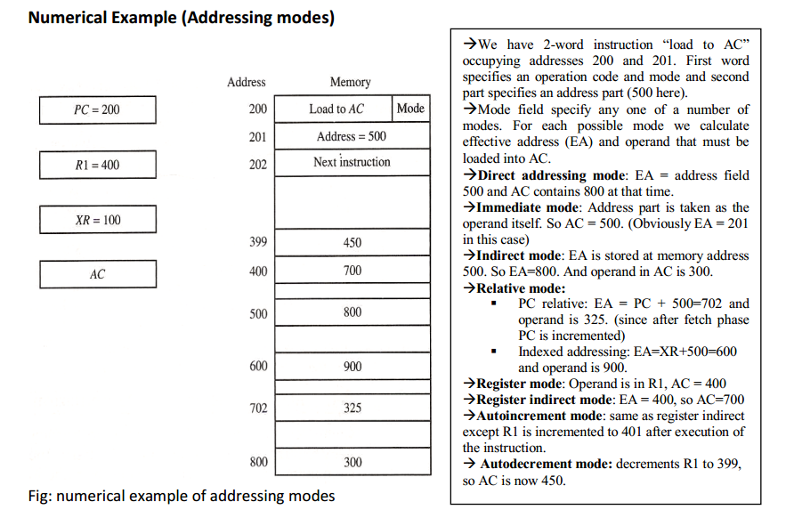

Slide 31
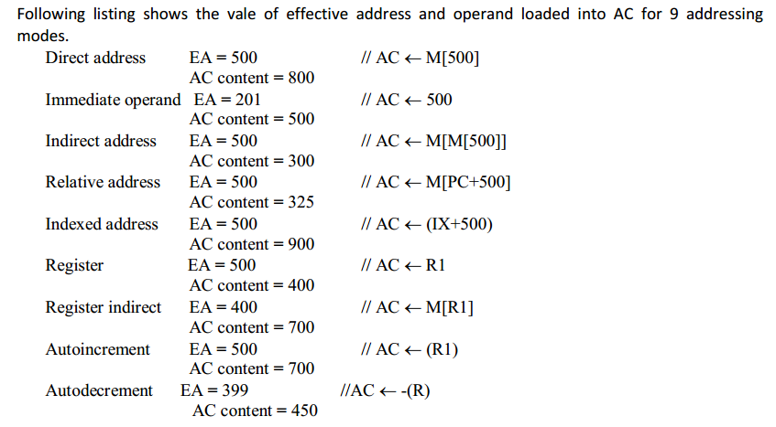

Slide 32
Data Transfer and manipulation
Data Transfer and Manipulation
Computers give extensive set of instructions to give the user the flexibility to carryout various computational tasks.
The actual operations in the instruction set are not very different from one computer to another although binary encodings and symbol name (operation) may vary.
So, most computer instructions can be classified into 3 categories:
1. Data transfer instructions
2. Data manipulation instructions
3. Program control instructions

Slide 33
Data Transfer instructions
Data transfer instructions causes transfer of data from one location to another without modifying the binary information content.
The most common transfers are:
between memory and processor registers
between processor registers and I/O
between processor register themselves
Table below lists 8 data transfer instructions used in many computers.

Slide 34
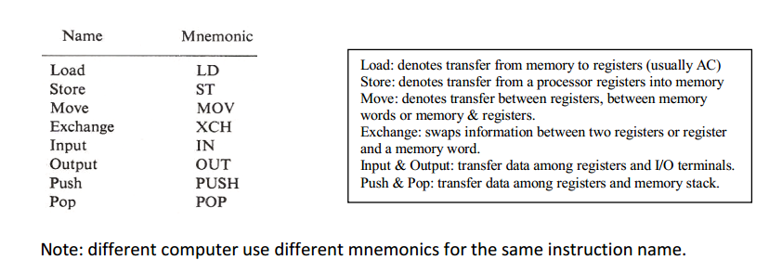

Slide 35
Instructions described above are often associated with the variety of addressing modes.
Assembly language uses special character to designate the addressing mode. E.g. # sign placed before the operand to recognize the immediate mode. (Some other assembly languages modify the mnemonics symbol to denote various addressing modes, e.g. for load immediate: LDI).
Example: consider load to accumulator instruction when used with 8 different addressing modes:

Slide 36
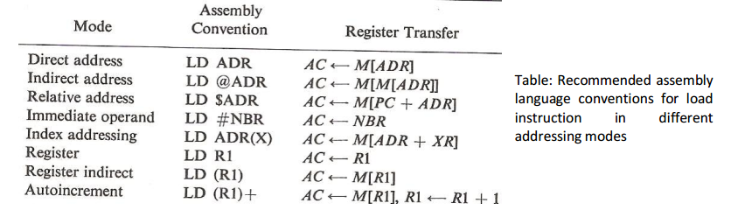

Slide 37
Data manipulation Instructions
Data manipulation instructions provide computational capabilities for the computer.
These are divided into 3 parts:
Arithmetic instructions
Logical and bit manipulation instructions
Shift instructions

Slide 38
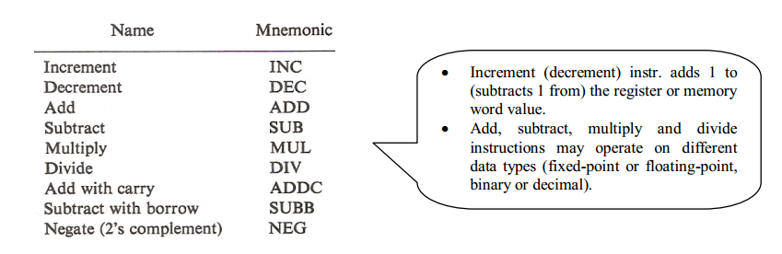
Arithmetic instructions

Slide 39
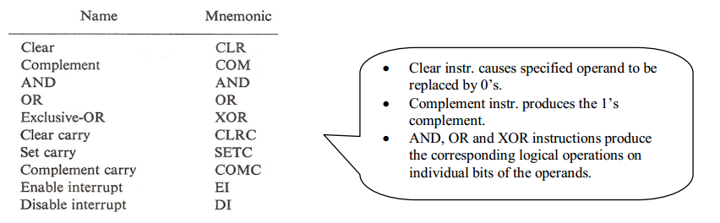
Logical and bit manipulation instructions

Slide 40
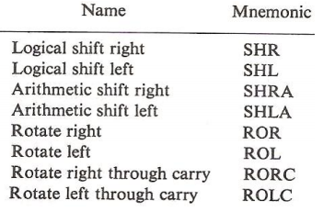
Shift instructions
Shifts instruction may be:
Logical shifts
Arithmetic shifts
Rotate-type operations

Slide 41
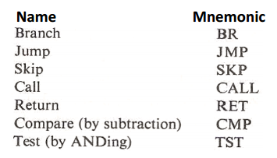
Program control instructions
Instructions are always stored in successive memory locations and are executed accordingly.
But sometimes it is necessary to condition the data processing instructions which change the PC value accidently causing a break in the instruction execution and branching to different program segments.

Slide 42
RISC and CISC
An important aspect of computer architecture is the design of the instruction set for the processor.
Early computers had small and simple instruction sets, forced mainly by the need to minimize the hardware used to implement them.
As digital hardware became cheaper with the advent of ICs, computer instructions tended to increase both in number and complexity.
Many computers have instruction sets that include 100-200 instructions employing variety of data types and large number of addressing modes and are classified as Complex Instruction Set Computer(CISC).
In early 1980s, a number of computer designers recommended that computers use fewer instructions with simple constructs so as to execute them faster with in CPU without using memory as often. This type of computer is classified as a Reduced Instruction Set Computer(RISC).

Slide 43
CISC
One reason to provide a complex instruction set is the desire to simplify the compilation (done by compilers to convert high level constructs to machine instructions) and improve the overall computer performance.
Essential goal: Provide a single machine instruction for each statement in high level language.
Examples: Digital Equipment Corporation VAX computer and IBM 370 computer.
Characteristics:
A large no of instructions - typically from 100 to 250 instructions.
A large variety of addressing modes –typically form 5 to 20.
Variable-length instruction formats
Instructions that manipulate operands in memory

Slide 44
RISC
Main Concept: Attempt to reduce execution time by simplifying the instruction set of the computer.
Characteristics:
Relatively few instructions and addressing modes.
Memory access limited to load and store instructions
All operations done with in CPU registers (relatively large no of registers)
Fixed-length, easily decoded instruction format
Single cycle instruction execution
Hardwired rather than Micro-programmed control
Use of overlapped-register windows to speed procedure call and return
Efficient instruction pipeline

